Slide 1

Debt Consolidation
Loan Partners with ClearOne
Updated 7/26/23

Slide 2



Lending Partners
When to Contact | Who to Contact | How to Contact
Pre-Funding "Eligible for Application" | Loan Referral Team | Thank the client for their interest but advise that we are not currently accepting applications through OneLoan and that if they are eligible for LUSA we will reach out to them
Pre-Funding with Application in Progress | OneLoan Direct | InContact: 'DC CS Inbound' Email: Customerservice@theoneloan.com
Post-Funding with Debt Settlement Concerns | Debt Consolidation Client Support | InContact: 'DC CS Inbound' Email: Customerservice@theoneloan.com Allow 24-72 business hours for response
Post-Funding with Loan Concerns | OneLoan Direct | OLD Loan Servicing: (833) 743-1707
When To Contact | Who to Contact | How to Contact
Pre-Funding "Eligible for Application" | Loan Referral Team | InContact: ‘Loan Referral Team’ Email Distro: 'LoanReferralTeam'
Pre-Funding with Application in Progress | LendingUSA | InContact: 'Lending USA Hot Transfer'
Post-Funding with Debt Settlement Concerns | Debt Consolidation Client Support | InContact: 'DC CS Inbound' Email Distro: 'COALoanSupport'
Post-Funding with Loan Concerns | Lending USA | LUSA Loan Servicing: (800) 994-6177

Slide 3











Lending Process Overview
Pre-Funding
COA & Partner Agree Client is Eligible Prospect for Lending
Loan Referral Team Contacts Client to Start Application
Client is Warm Transferred to Loan Partner to Complete Application
Decision is Made by Loan Partner if they can Lend to our Client
Loan Contract is Signed and Funds sent to GH- Customer Company name updates in QuickBase
DC Client Support Contacts Client for Funded Call and Sets Expectations for Expedited Graduation
Post-Funding
PRT Expedites Settled Debt
Negotiations is Assigned to Eligible Accounts to Settle
Day 31 of Funding DC Negotiations is Assigned by Client
DC Client Support Contacts Client for Graduation Call and Lending Partner Expectations
All Creditors are Settled and DC Client Support Reviews for Pre-Grad Readiness

Slide 4
Before GH Funding
Client wants to add/remove an account
Ensure the account has not already been added/removed
Client has questions on terms, rate, monthly payment for their Loan
Advise client that we do not currently have those terms but that upon approval of the application they will be provided​ all details from their Lending Partner
Obtain authorization recording and email DCLoanAdmin@clearoneadvantage.com using the Lending Remove quick reply
“That is a great question. Until the application is submitted and approved, we don’t know what those terms will be. Legally we are unable to discuss those details since we are not the one providing the loan. Once the application is approved, your Lending Partner will go over all of those details with you.”
Encourage client to keep all eligible accounts in program

Slide 5
Debt Consolidation Client Support
Client has Funded
Client has Inquires About their Debt Settlement Progress
DC Client Support
COA DC Status: "Funded 0-30"
GH has funds pending from Loan Partner
Adding/Removing Debt
Settlement Concerns
Draft Concerns
Graduation Inquires
InContact:
  'DC CS Inbound'
Inbound Number:
  877.365.0672
Inbound Email:
  coaloansupport@clearoneadvantage.com

Slide 6
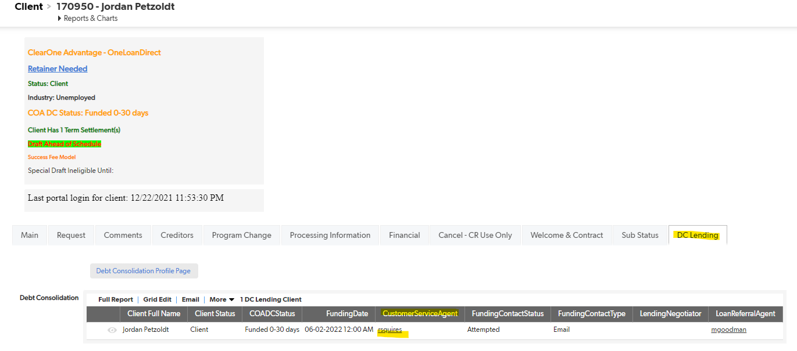
Contacting DC CS
QuickBase:
Client Page > DC Lending Tab
InContact:
Calling the 'DCCS' Skill- the IVR will identify the assigned DC CS agent and call that agent directly if they are logged into InContact

Slide 7
Client Empowerment
All Clients Gain:
Financial Stability
Expedited Graduation from Debt Settlement Company
More COA Contact for Global Authorizations
Future Scheduled Drafts are Removed to Utilize Loan Funds
Continuation of Loan Payments for Positive Payment History
Lending Partner Establishes Payment Terms for Loan Funds
All Unsettled Creditors are Contacted to Obtain Lump-sum Settlements

Slide 8
Client Relations & Canceling
DC Client Support will attempt to soft save & warm transfer to CR for cancels that need additional support
Client Requests to Cancel
Does it benefit the client's circumstances to reject the loan offer and maintain their debt settlement program?
Resolve:
How far has the client gotten in the DC Pipeline
Discover:
COA needs to notify the Lending Partner of any changes/rejection of the loan
Resolve:
Debt Settlement Option
Finalizing Cancel
Starting a cancel request & contacting DC Loan Product before submitting to Accounting
Pre-funding: Client will not incur any cost of the loan and cancel can proceed as normal
Post-funding: Any money used to expedite/settle is client's responsibility to the Lending Partner. Any funds in GH must be returned to Lending Partner before cancel is finalized in QB to reduce the principle of the loan
If client is saved by offering to maintain debt settlement program for unsettled accounts, customer company name will need to be addressed before changes in calc can be saved.

Slide 9
COA DC Statuses
Status Name | Team | Description
Eligible for Application | LRT | Client has been pre-selected and has not spoken with Loan Referral Team yet
Application Processing | Loan Partner | Client has started application and it is being processed by Loan Partner
Application Info Need | Loan Partner | Loan Partner is requesting additional information from the client for their application
Application Declined | DSP con't. | Application was declined, client will receive loan decision reasons from Loan Partner
Funding Form Processing | COA Quality | ClearOne is confirming payoff amount for Loan Partner
Application Pending Approval | Loan Partner | Client's application is progressing and waiting for Loan Partner action
DC Contract Awaiting Signature | Loan Partner | Client's loan contract was sent by the Loan Partner
Funded | DCCS & Negotiations | Client has loan funds in Global Holdings and Negotiations is being prioritized
Funded- Awaiting COS | DC PRT | LendingUSA has requested documentation regarding settlements
Client Rejected Loan Offer | DSP con't. | Client turned down lending opportunity
Loan Offer Expired | DSP con't. | Client's application went unaddressed, to inquire about restarting process contact Loan Referral Team
Lending Underwriting Disqualified Client | DSP con't. | Lending Partner was not able to extend loan per lending decision & will notify client
Funded- All Debt Settled with Uncleared Payments | DC PRT | One or more payments need to be expedited to creditors
Funded- All Debt PIF with Open Requests | Request Owner | Open requests need to be addressed before client can graduate
Funded- All Debt Settled with Pending GA | BPO - BB | Client's Global Auth is required to make payments to final creditor(s)
Funded All Debt PIF with Advance Uncollected | DC PRT | An outstanding advance needs to be assessed by Accounting
Funded- Refund Ready | DC PRT | Client has a balance in Global that needs to be sent to Lending Partner by Program Graduation Team
Funded- Graduation Eligible | DC PRT | Client meets all requirements to graduate from debt settlement program
Funded- Graduation Complete | Loan Partner | Client is completed with ClearOne

